Slide 1

PHYS60022 Data Science and Machine Learning for Physics
Week 2: Hypothesis Testing
Spring 2025

Slide 2
Hypothesis Testing
Up to this point we have discussed probability and how we can predict how often we might measure the various possible outcomes of our experiment.
Statistics, on the other hand, involves studying data we measure to try to determine the values and uncertainties of physical quantities.
We can therefore think of probability and statistics as inverse problems of one another:
Studying probability allows us to take physical constants and predict likely outcomes of an experiment
Studying statistics allows us to take the actual outcome of an experiment and find the models / physical constants of those models that are compatible with data
PDF
Data

Slide 3
Hypothesis Testing
To decide whether our data are compatible with a particular model, we first need to define that model.
We typically have some model (or set of models) in mind that we are comparing to our data
→ We call this the null hypothesis H₀

Slide 4
Hypothesis Testing
To decide whether our data are compatible with a particular model, we first need to define that model.
We typically have some model (or set of models) in mind that we are comparing to our data
→ We call this the null hypothesis H₀
f(X)
X_{m}
Consider H₀ = a PDF f(X) for a continuous variable X, and a single measurement (data point) X_{m}.
If H₀ is correct is then we expect the measurement X_{m} to be in a region where the PDF is large
X

Slide 5
Hypothesis Testing
To decide whether our data are compatible with a particular model, we first need to define that model.
We typically have some model (or set of models) in mind that we are comparing to our data
→ We call this the null hypothesis H₀
f(X)
X_{m}
Consider H₀ = a PDF f(X) for a continuous variable X, and a single measurement (data point) X_{m}.
If H₀ is correct is then we expect the measurement X_{m} to be in a region where the PDF is large
If the measured value X_{m} lies in a region of the PDF with low probability, we would reject H₀
How can we quantify this? We need to introduce the concept of errors.
X

Slide 6
Type-I errors
To choose when we would/wouldn’t reject H₀, We define a critical region (or sometimes called a “rejection region”) with the condition that
Where 0 < α < 1 is some predetermined value, known as the Type-I error rate. You will also see this referred to as the “significance level” (more on that in the next discussion session)
Note we used a conditional probability here f(X|H₀) which you read as “the probability density for X under the assumption H₀ is true hypothesis”
Often this will be implicit so we’ll leave out the H₀

Slide 7
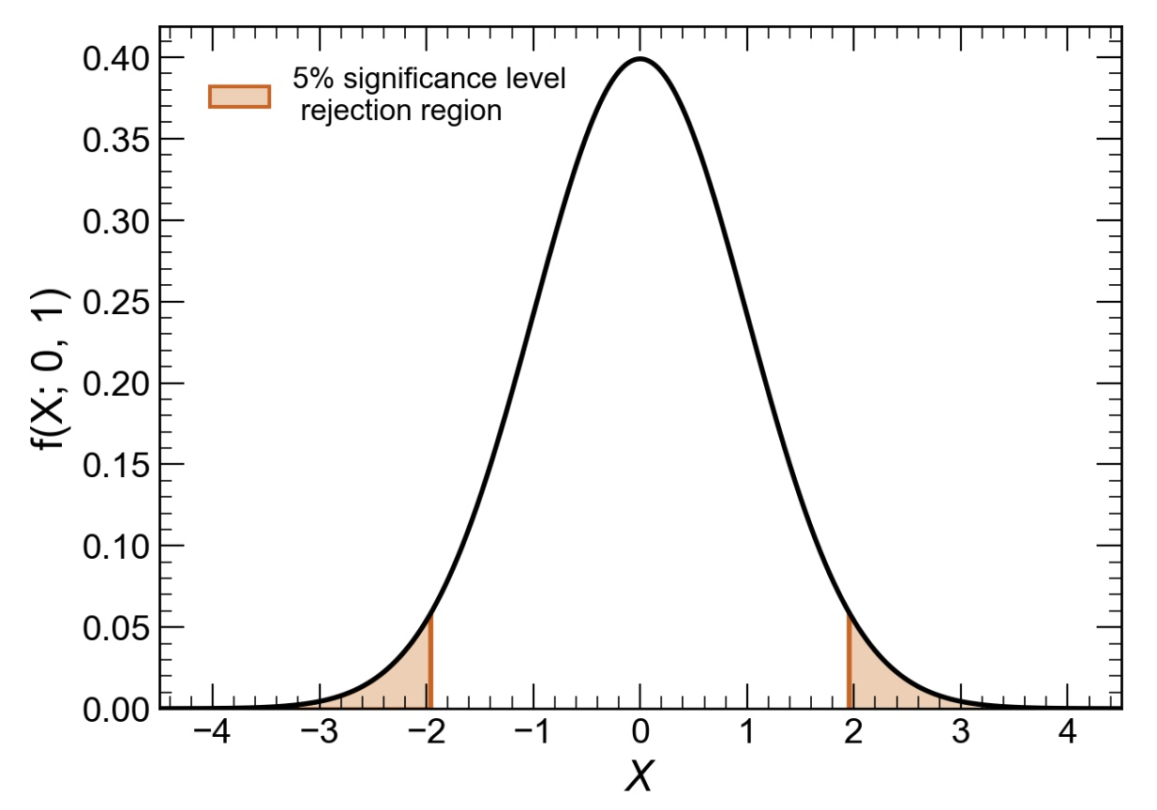
Type-I errors
To choose when we would/wouldn’t reject H₀, We define a critical region (or sometimes called a “rejection region”) with the condition that
Where 0 < α < 1 is some predetermined value, known as the Type-I error rate. You will also see this referred to as the “significance level” (more on that in the next discussion session)
Note we used a conditional probability here f(X|H₀) which you read as “the probability density for X under the assumption H₀ is true hypothesis”
Often this will be implicit so we’ll leave out the H₀
Example for H₀ = Normal distribution, α=0.05
f(X|H₀)
There is a 5% chance that X_{m} lands in the orange region when H₀ is true → 5% of the time, we will incorrectly reject H₀!

Slide 8
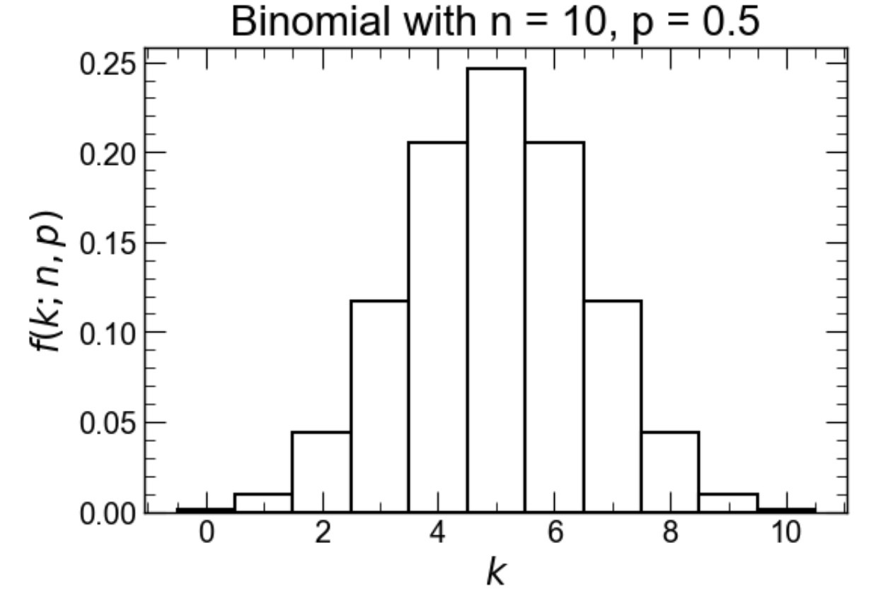
Example
Consider flipping a coin 10 times. We would like to know if the coin is unbiased.
We expect these measurements to obey a binomial distribution as there are two possible outcomes each time, heads or tails. If the coin is unbiased, we would expect the probability of a heads to be equal to the probability of a tails, p = 0.5. Let’s say the random variable k = # of heads
Null hypothesis H₀:= Binomial distribution with p = 0.5 and n=10 or
H₀ := k~B(k;10,0.5)
Choose significance level of α=0.05

Slide 9
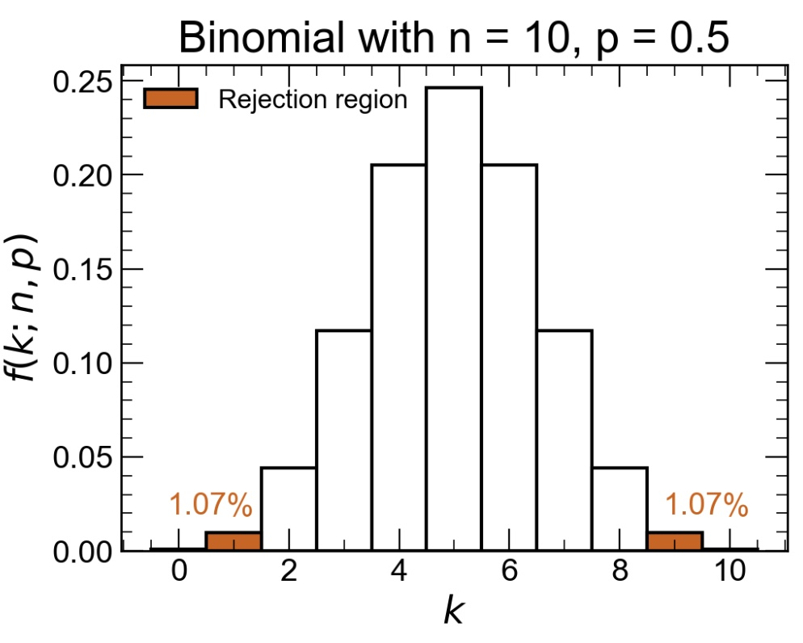
Example
Consider flipping a coin 10 times. We would like to know if the coin is unbiased.
We expect these measurements to obey a binomial distribution as there are two possible outcomes each time, heads or tails. If the coin is unbiased, we would expect the probability of a heads to be equal to the probability of a tails, p = 0.5. Let’s say the random variable k = # of heads
Null hypothesis H₀:= Binomial distribution with p = 0.5 and n=10 or
H₀ := k~B(k;10,0.5)
Choose significance level of α~0.05
Both small and large values of k would indicate that the coin is biased.
k small → biased towards tails, k large → biased towards heads
Hypothesis test is therefore two-sided rejection region.
In this case, since our random variable is discrete, we cannot choose a region with α=0.05.

Slide 10
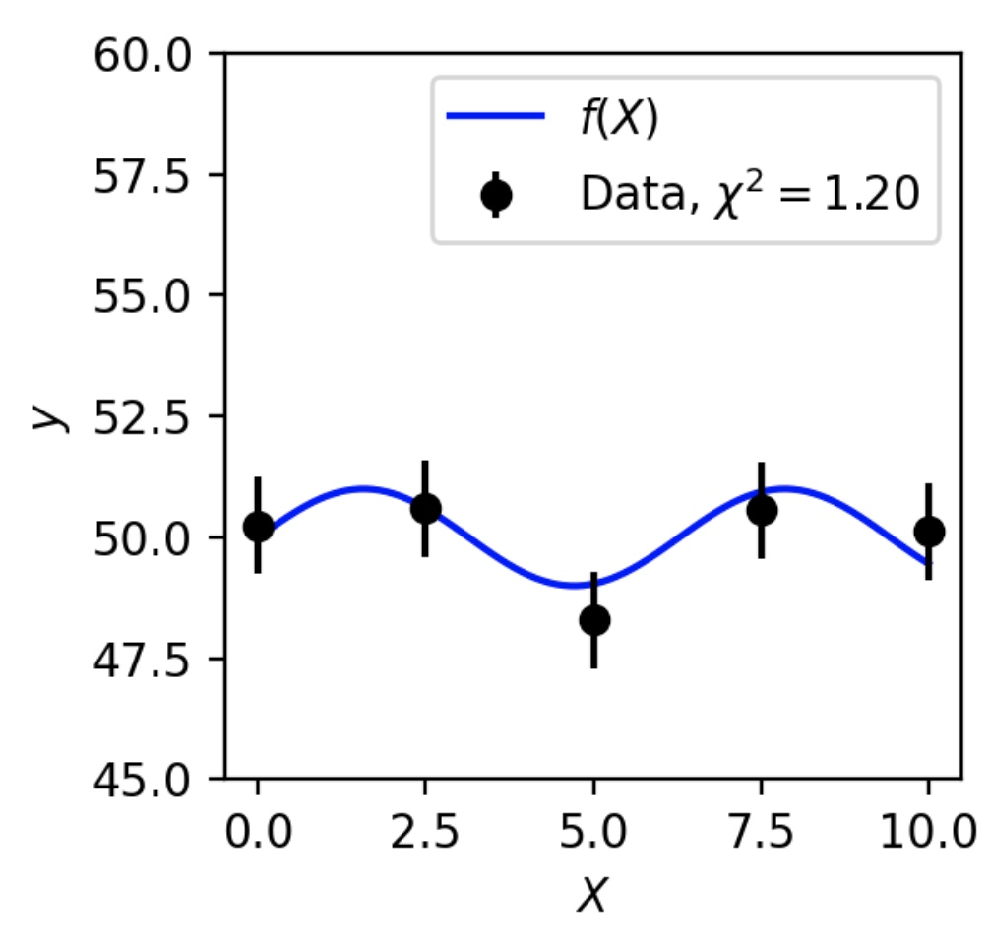
Test-statistics
What if our measurement consists of lots of data, not just a single measurement of a random variable? After all experiments today are all about Big data right?
We need to find a function that summarizes the data in some way so that we can proceed as before → we call this function a test-statistic
There are many many different test-statistics in the wild, today we will take a look at two extremely common ones that are particularly useful in ML applications…
χ² test-statistic
Kolmogorov-Smirnov (K-S) test-statistic

Slide 11
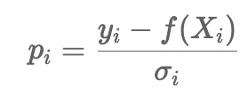
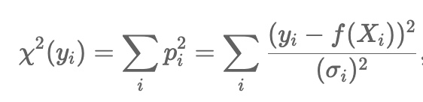
χ² test-statistic
For a set of N measurements { X_{i}, y_{i} } and some function f(X), we define the residuals
Where σ_{i} represents the “uncertainty” on each measured variable y_{i} and f(X) is a function of controlled variable X.
The χ² test-statistic is defined as the sum of residuals squared,
We define the critical region based on the distribution of this test-statistic under the null hypothesis

Slide 12
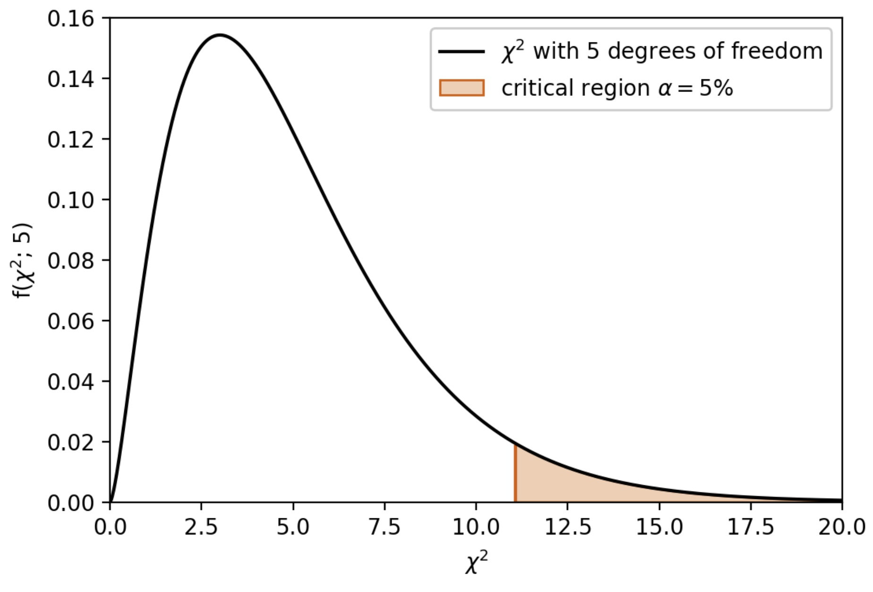
χ² test-statistic
If we assume that each measured variable y_{i} is independently distributed as a Gaussian random variable* with mean f(X_{i}) and variance σ_{i}² then χ² will be distributed as a chi-square distribution with N degrees of freedom
In our case N=5
Large values of χ² indicate poor compatibility of the data with f(X)
We would reject the null hypothesis (the hypothesis that the data are compatible with f(X) if we found χ² > 11 for our data
* Note, that we can still use the test-statistic without this assumption, but the distribution would not necessarily be known in that case

Slide 13
χ² test-statistic
If we assume that each measured variable y_{i} is independently distributed as a Gaussian random variable* with mean f(X_{i}) and variance σ_{i}² then χ² will be distributed as a chi-square distribution with N degrees of freedom
This can be confusing since both the test-statistic and it’s distribution under the null hypothesis are called “chi-square”.
Remember there is a difference as one is a function of the data and the other is a PDF!
In our case N=5
Large values of χ² indicate poor compatibility of the data with f(X)
We would reject the null hypothesis (the hypothesis that the data are compatible with f(X) if we found χ² > 11 for our data
* Note, that we can still use the test-statistic without this assumption, but the distribution would not necessarily be known in that case

Slide 14
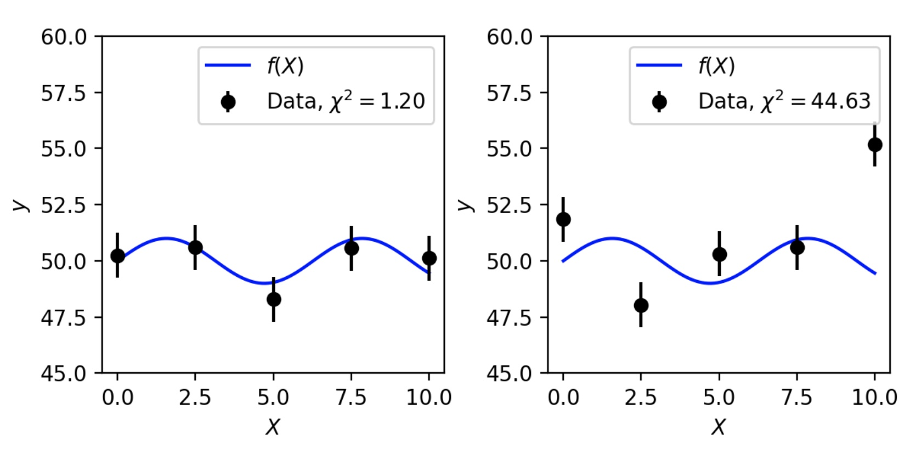
χ² test-statistic
Large values of χ² indicate poor compatibility of the data with f(X)
Values of χ² ~ N indicate good compatibility of the data with f(X)

Slide 15
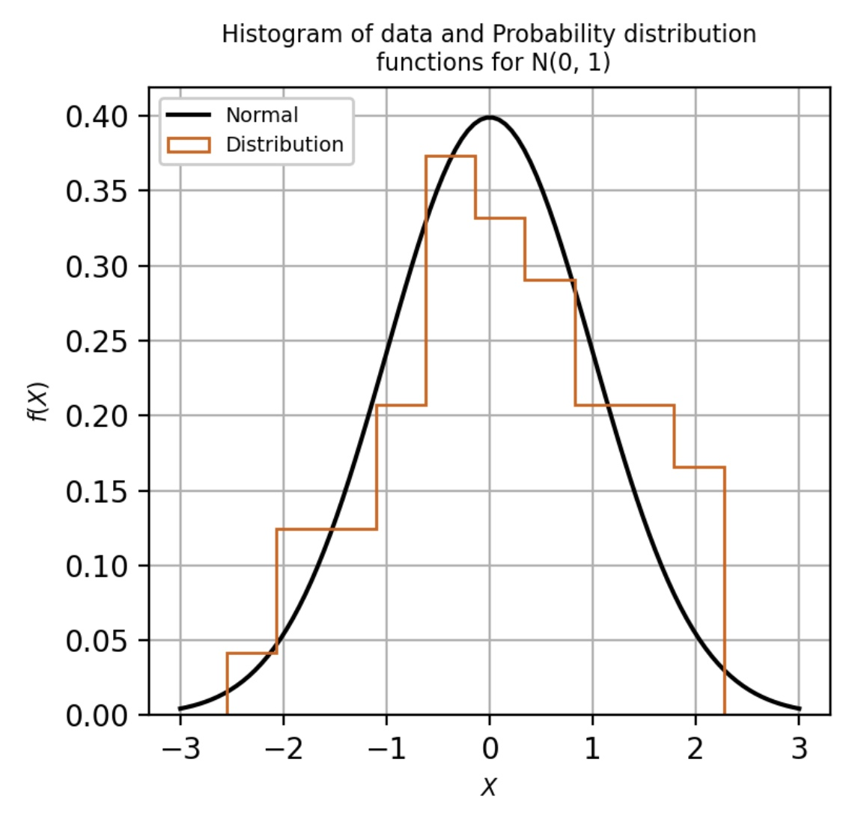
Kolmogorov-Smirnov test-statistic
The Kolmogorov-Smirnov (K-S) test compares the cumulative distributions of data and a model (or in the case of the 2-sample version, it compares the distributions of two data sets)

Slide 16
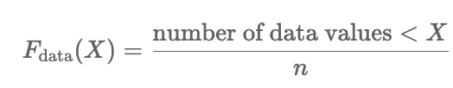
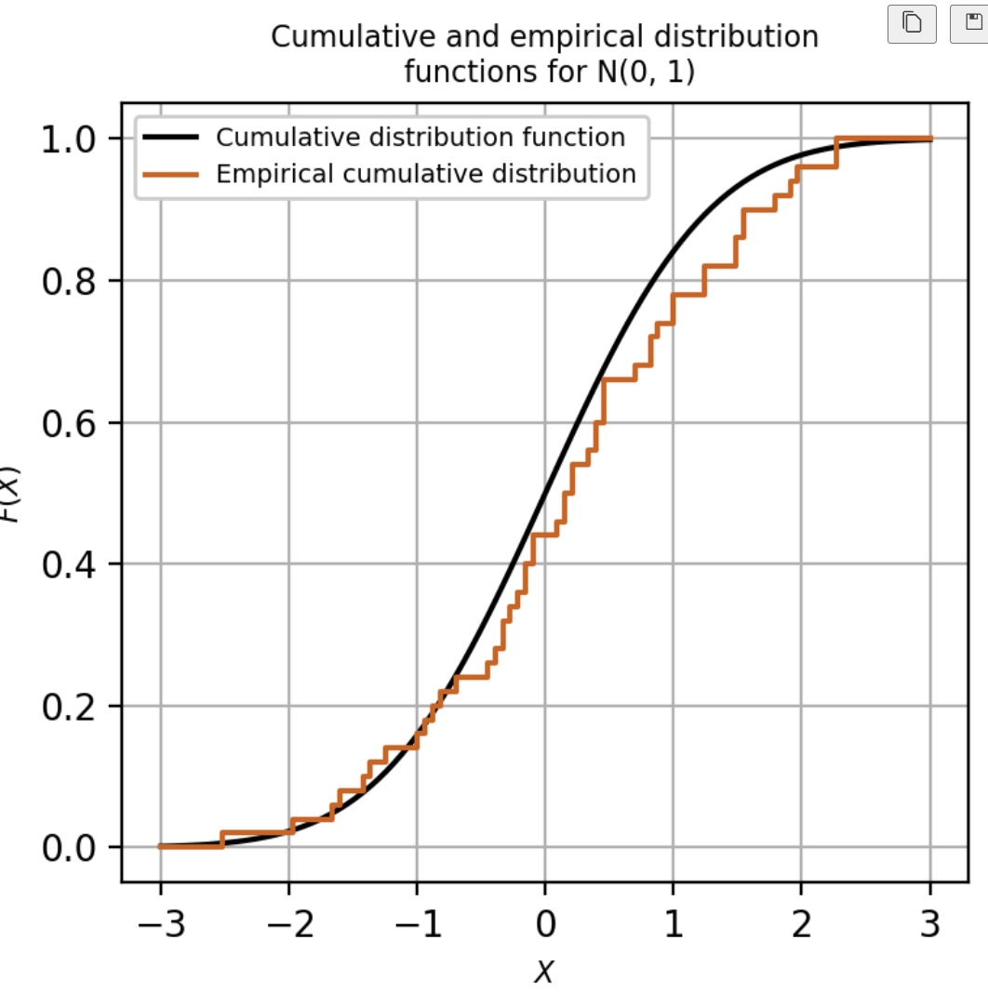
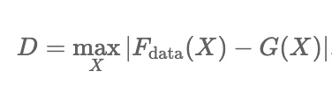
Kolmogorov-Smirnov test-statistic
The Kolmogorov-Smirnov (K-S) test compares the cumulative distributions of data and a model (or in the case of the 2-sample version, it compares the distributions of two data sets)
We define the empirical cumulative distribution function for a data set (of independent random variables) of size n as,
The K-S test-statistic D is defined with respect to the null hypothesis H₀ := X~g(X) as,
Where G(X) is the cumulative distribution function of g(X).

Slide 17
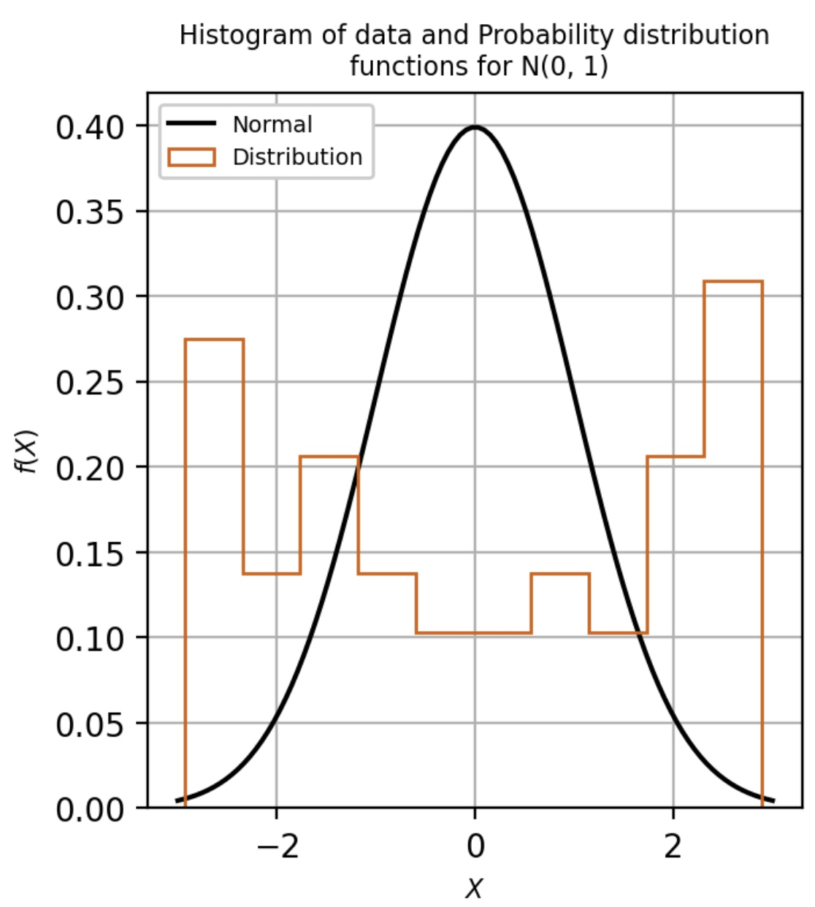
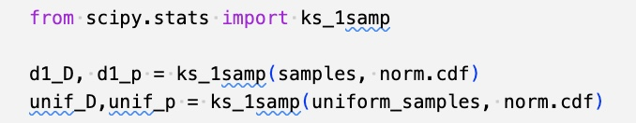
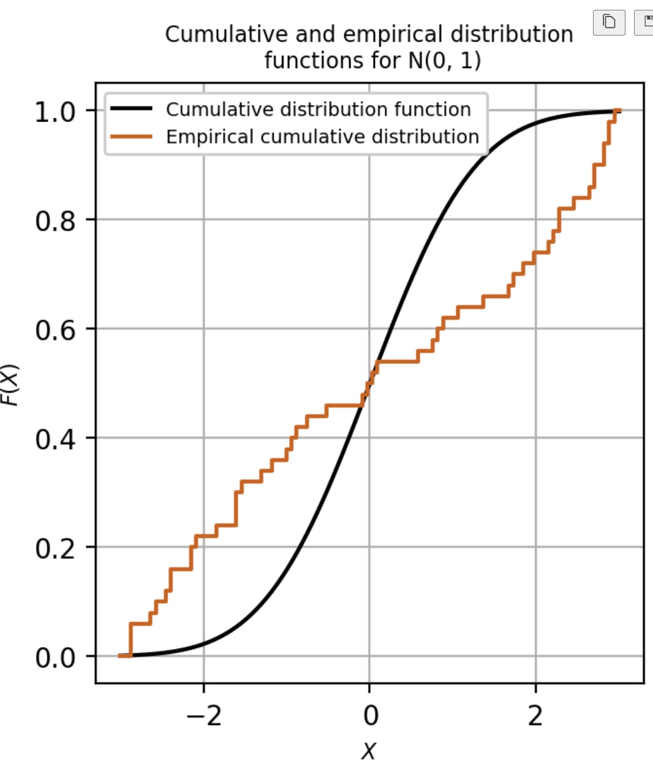
Kolmogorov-Smirnov test-statistic
We can use the scipy.stats ks_1samp to calculate the value of D for us
Small values of D indicate good compatibility between data and H₀
Large values indicate poor compatibility
D = 0.285
D = 0.107

Slide 18
P-values (an aside)
Note that the ks_1samp function also returns something called a p-value
We will have a discussion session on p-values and the concept of significance but for now, just know that a p-value is just a tail probability of the distribution of the test-statistic under some hypothesis (typically the null)

Slide 19
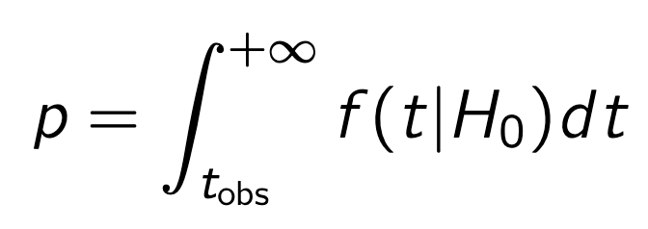
P-values (an aside)
Note that the ks_1samp function also returns something called a p-value
We will have a discussion session on p-values and the concept of significance but for now, just know that a p-value is just a tail probability of the distribution of the test-statistic under some hypothesis (typically the null)
As an integral it is defined as
This gives us a quick way to know if t_{obs} is in the critical region since
p < α ←→ t_{obs} in critical region
We need to either know or simulate the distribution of
t to calculate a p-value!
t_{obs}
p

Slide 20
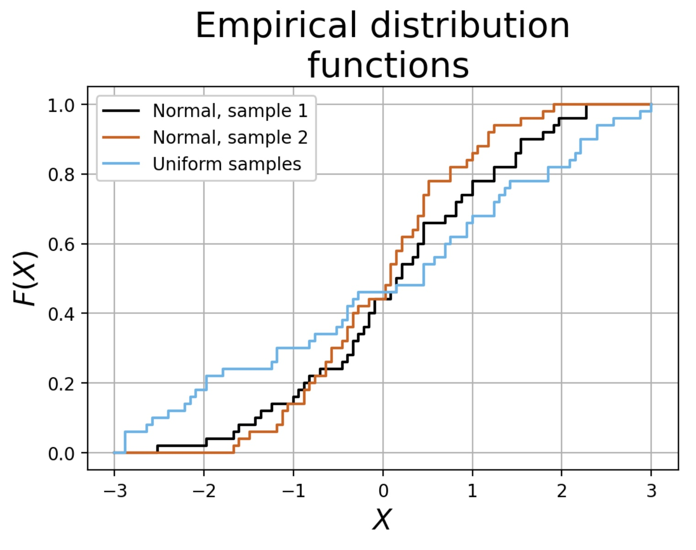
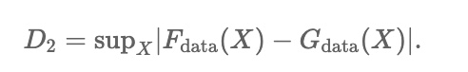
2-sample K-S test
The two-sample K-S test is used for two data sets. It is defined as
In this case, the null hypothesis H₀ is defined as the hypothesis that both samples are drawn from the same distribution
This test is extremely useful when testing for overtraining in ML models if using a test/train split of your data (more in later weeks)
There is a ks_2samp function in scipy to calculate D₂
G_{data}(X)
F_{data}(X)

Slide 21
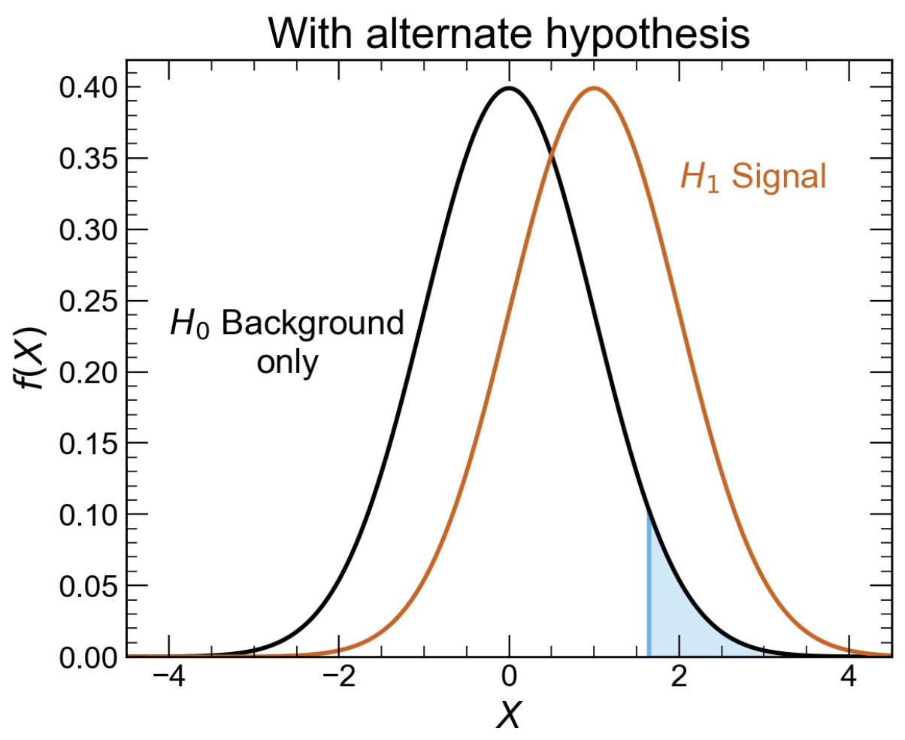
Alternate Hypotheses (H₁) and the power of a test
So far, we have looked at a few test-statistics to test the compatibility of data with our null hypothesis.
How can we know which of these, or any other test, is the best test to use?
The answer will depend on which other hypotheses might be more compatible with the data
We need to consider an alternate hypothesis H₁

Slide 22

Alternate Hypotheses (H₁) and the power of a test
So far, we have looked at a few test-statistics to test the compatibility of data with our null hypothesis.
How can we know which of these, or any other test, is the best test to use?
The answer will depend on which other hypotheses might be more compatible with the data
We need to consider an alternate hypothesis H₁
Example, consider X as the number of events at the LHC in the search for a new particle. We might expect more events in the presence of a signal compared to the background only

Slide 23
The power of a test
1 -
With H₁ defined, we can now define the power of a particular hypothesis test
Where g(X) is the distribution of the random variable X under the alternate hypothesis
Note that the power of the test is related to the probability to falsely reject H₁ → β is the Type-II error rate

Slide 24
The power of a test
1 -
With H₁ defined, we can now define the power of a particular hypothesis test
Where g(X) is the distribution of the random variable X under the alternate hypothesis
The power will depend on the alternate hypothesis that we choose
Different tests are better or worse for different purposes
The power will depend on what we choose as the critical region (and the value of α)
There will be a trade-off between β and α
Note that the power of the test is related to the probability to falsely reject H₁ → β is the Type-II error rate

Slide 25
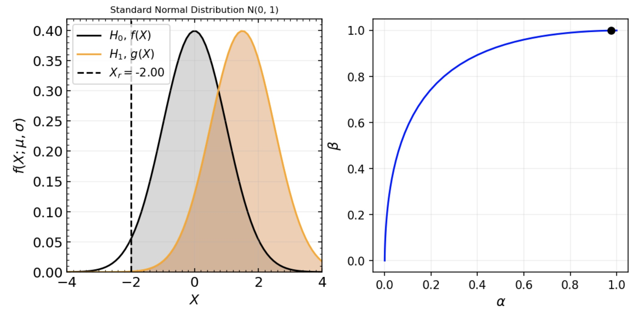
Gaussian Example
1 -
1 -

Slide 26
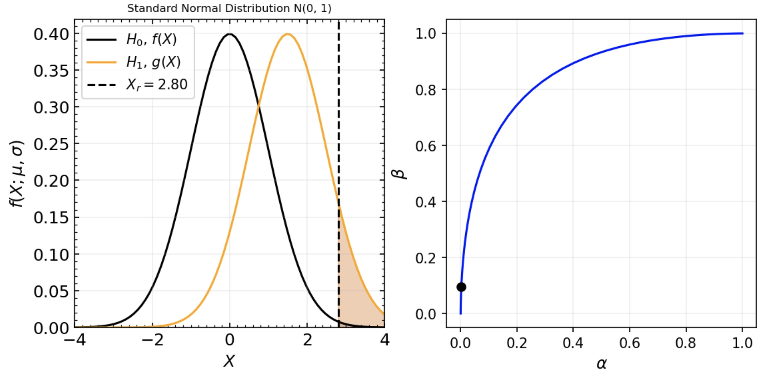
Gaussian Example
1 -
1 -

Slide 27
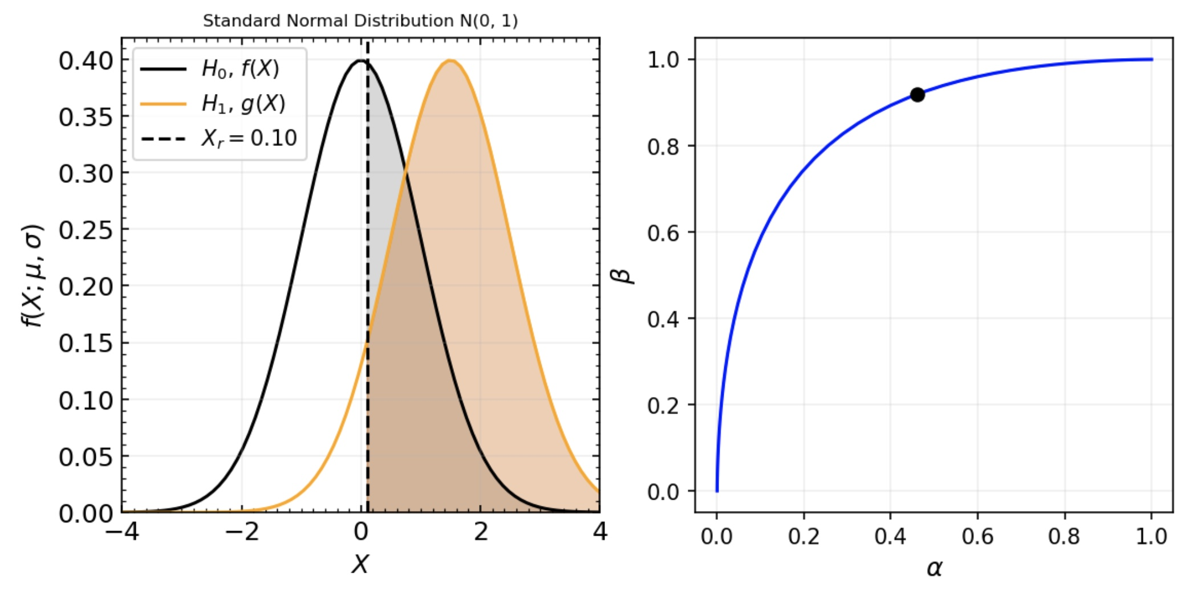
Gaussian Example
1 -
You will meet this kind of graph again when you train ML classifiers → it is known as a ROC curve
1 -

Slide 28
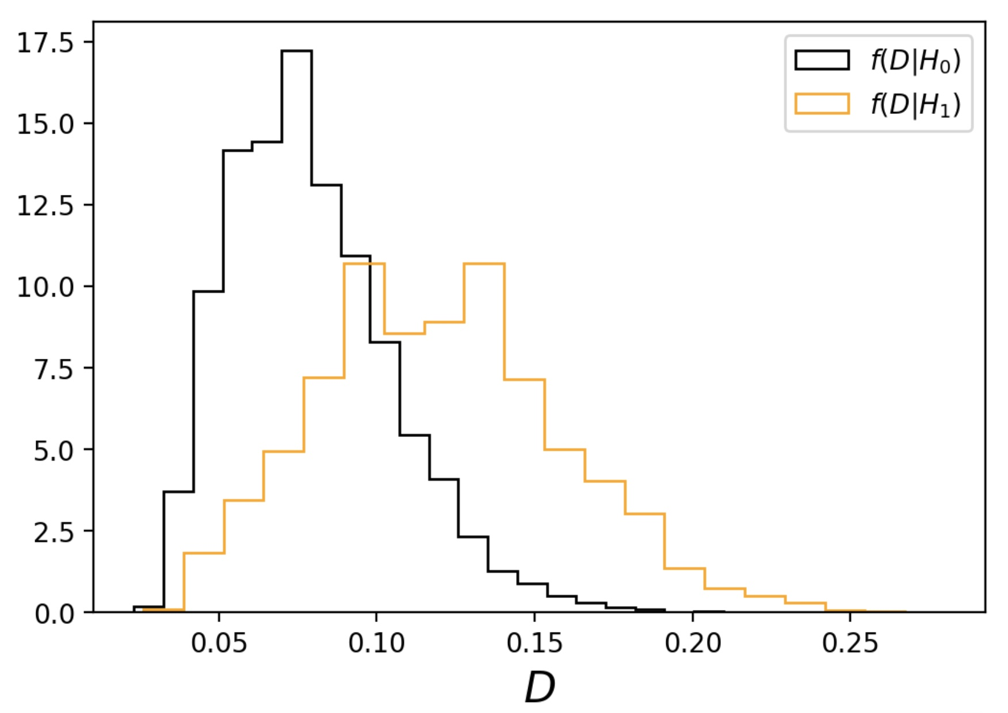
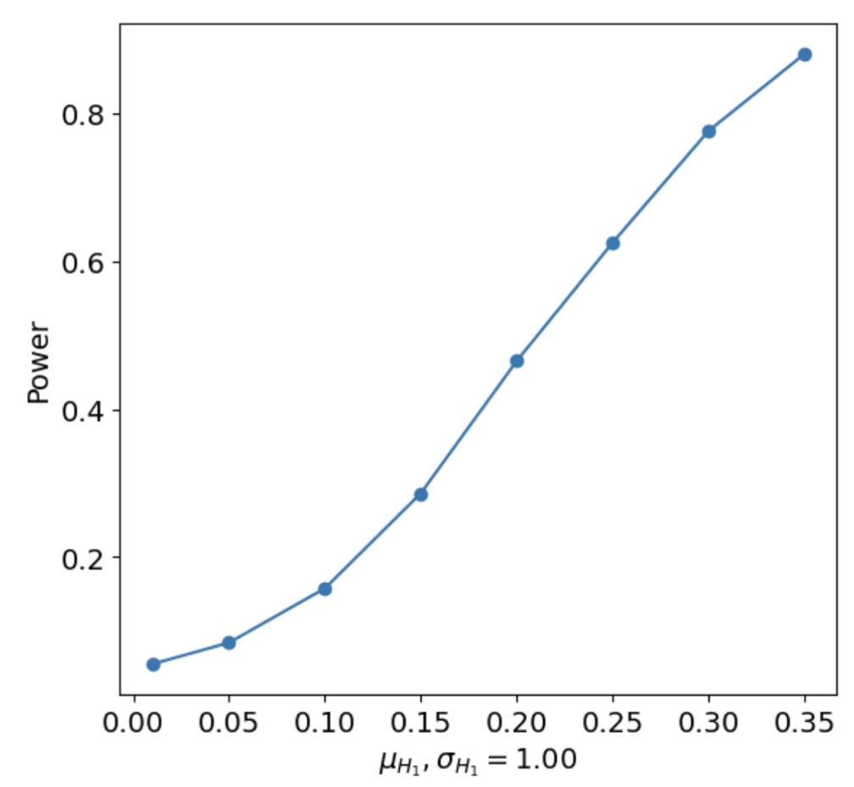
K-S test power calculation
Example: Calculate the power for a K-S test where
H₀ = standard normal distribution
H₁ = same as H₀ but with variable μ_{H1} parameter
α=0.05, sample size = 100
In this week’s notebook, you have some Hypothesis test exercises using scipy

